Slide 1
WHO AM I?

Slide 2
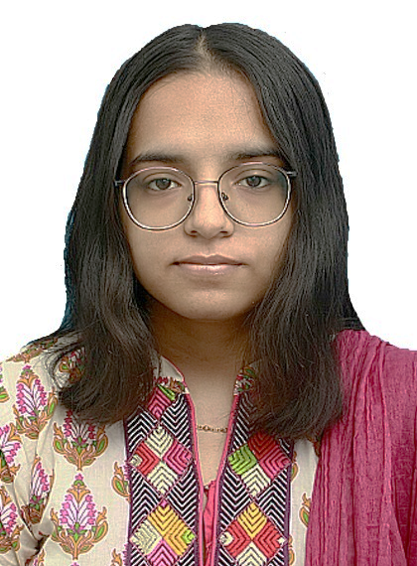
BASIC INTRO: ABEER MANSOOR ERP: 24607 AGE : 18 YEARS DATE OF BIRTH : 15 SEPTEMBER, 2003

Slide 3
EDUCATION:
I completed my matriculation from SMS AGA KHAN SCHOOL.
I completed my intermediate from (AKHSS) AGA KHAN HIGHER SECONDARY SCHOOL.
I am currently enrolled in the BBA program in the (IBA) Institute of Business Administration.

Slide 4
INSIGHT ON MYSELF:
I am an active learner. I can work effectively in content writing and graphic designing as well.
My future goals consist of doing something related to entrepreneurship and hopefully having my own setup.

Slide 5
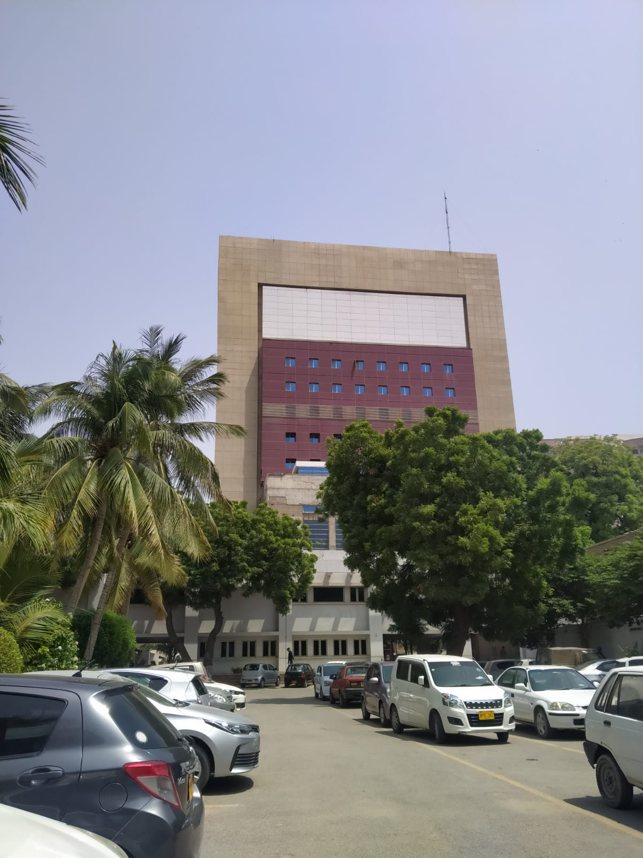
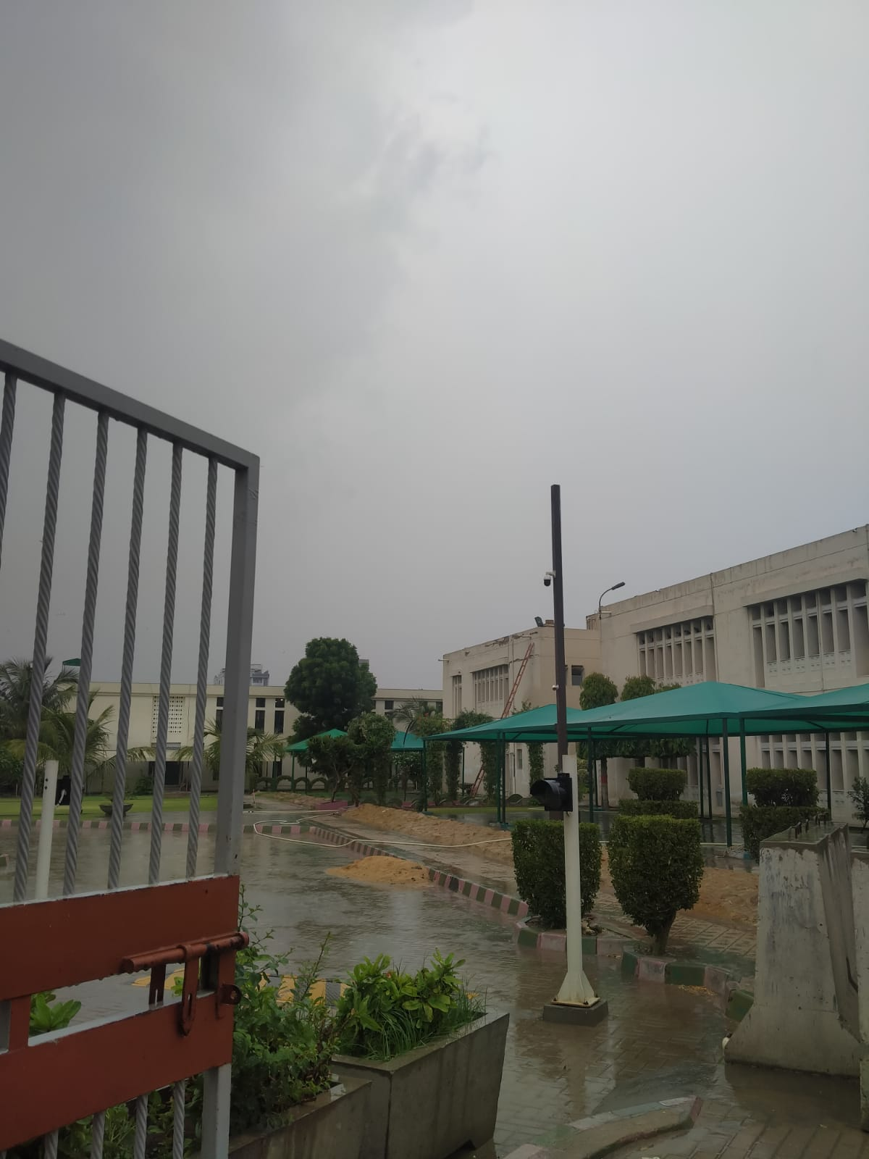
IBA
AKHSS

Slide 6
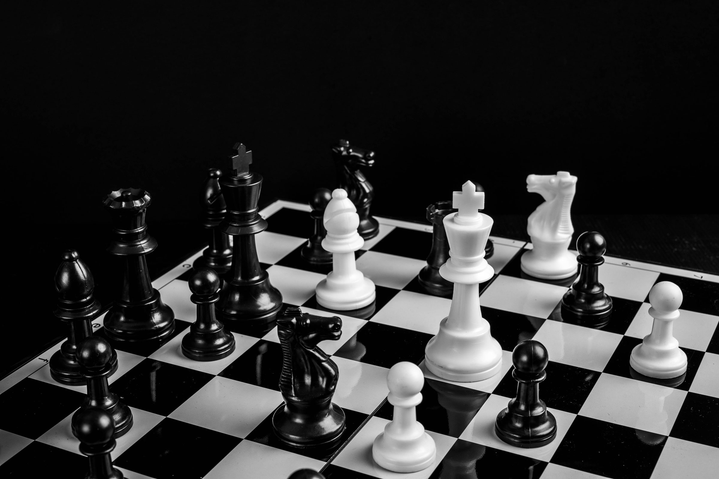

INTERESTS
I like to play chess as a hobby usually. It helps me use my mind in an effective manner and is also a good brain exercise.
I also enjoy painting landscapes. It helps me reshape my creative side.

Slide 7
The song I have been listening to a lot lately:
September by Earth, Wind and Fire.
I love listening to this song because it reminiscences pleasant memories and its such a happy song. It never fails to cheer me up.

Slide 8
virgo

Slide 9
My zodiac sign is virgo and I do posses some of the qualities Virgos are known for. I like to organize things like Virgos usually do. I have a specific taste and take my time in choosing things too.

Slide 10
I adore cats. Whenever I stumble upon cats, they make my day. I always flood my camera roll with pictures of cats I capture. It just one of the things that I have grown to do more and more lately.
Here are some of pictures I have of cats at this moment:

Slide 11
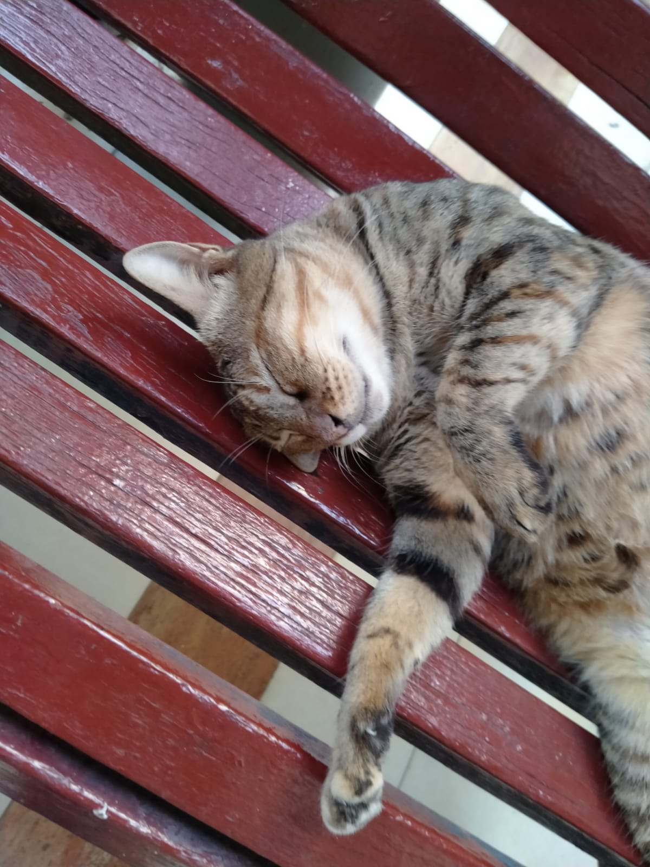
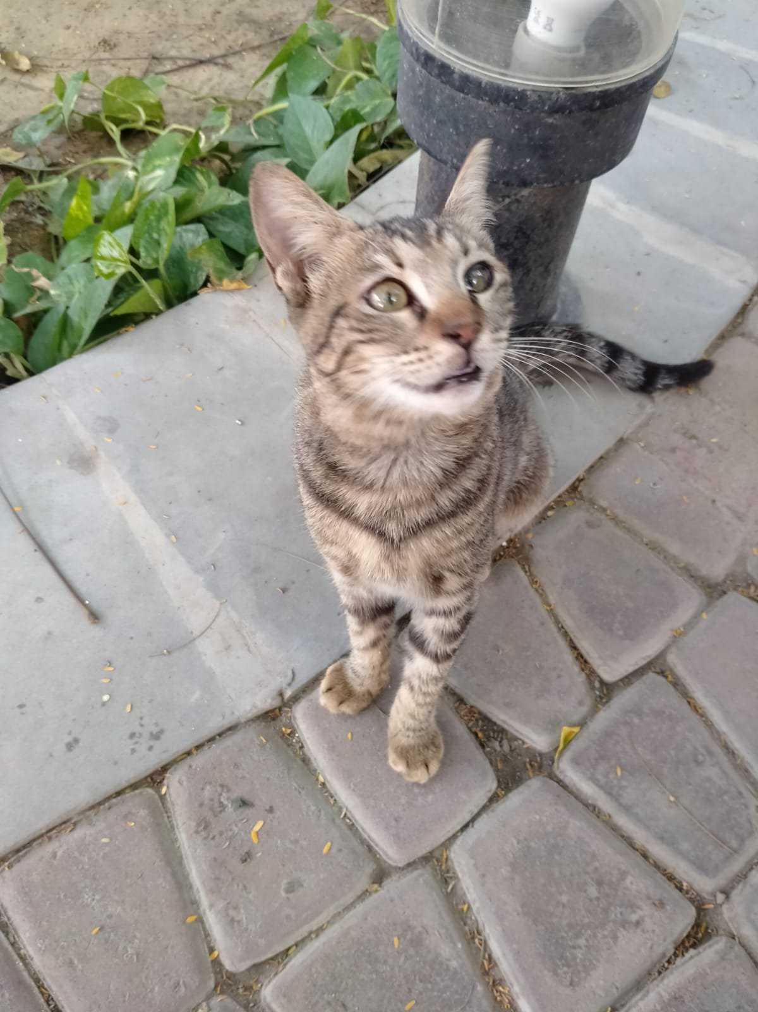
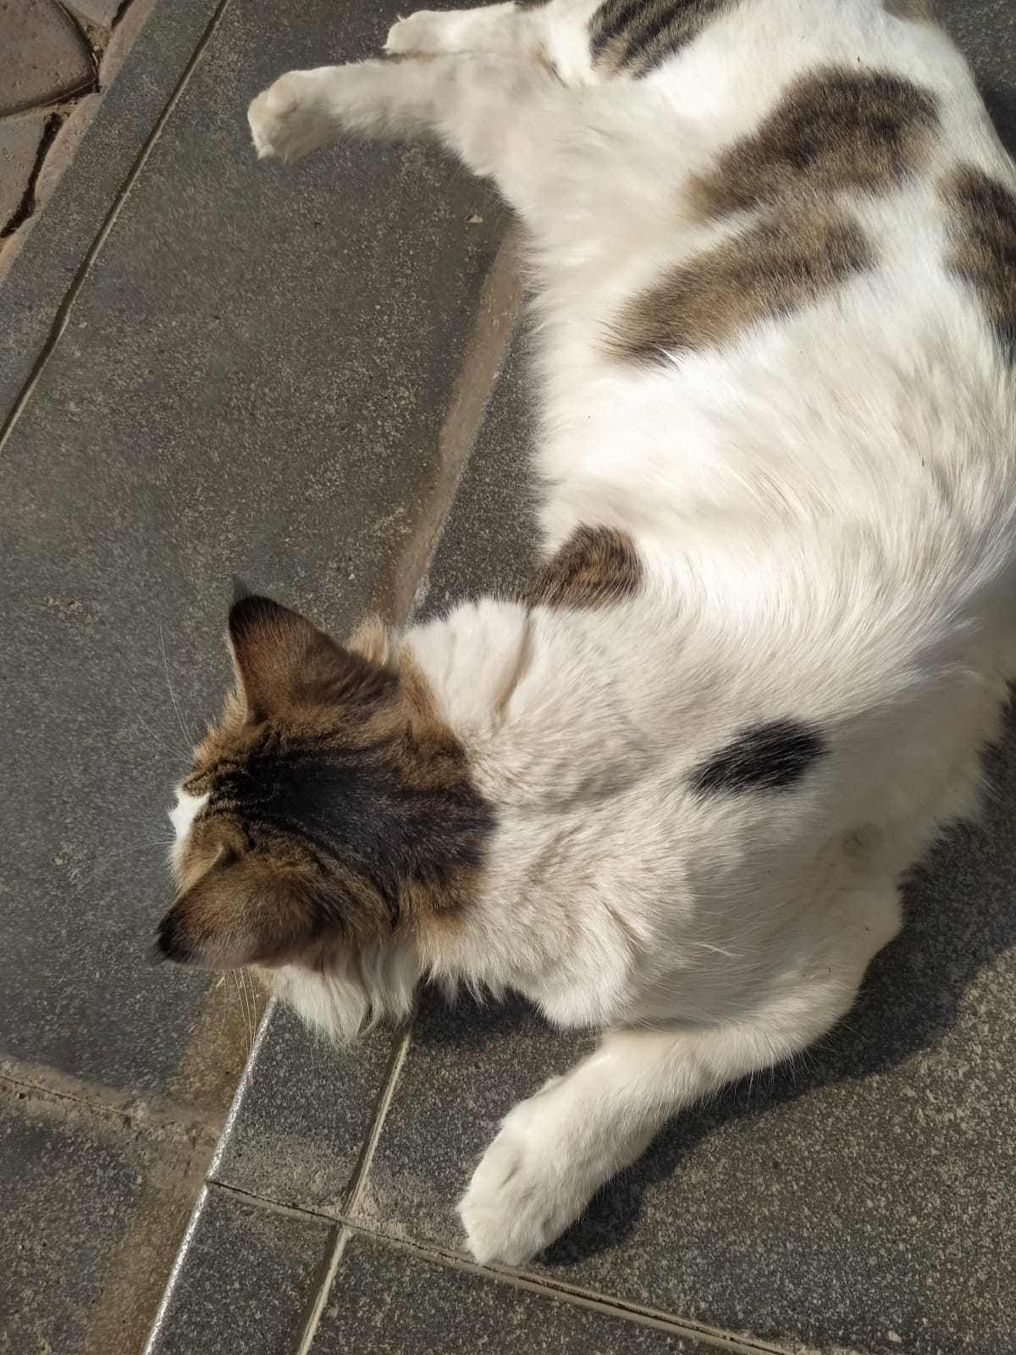

Slide 12
Living in Karachi:
Since I was born in Saudia Arabia, I got the taste of living in Karachi a little later than most. But what I gained as an insight that this is a busy and rightfully quoted “ a city that never sleeps”. I have a massive history and culture for this city. Now, I call it my home and cant imagine living in another city.

Slide 13
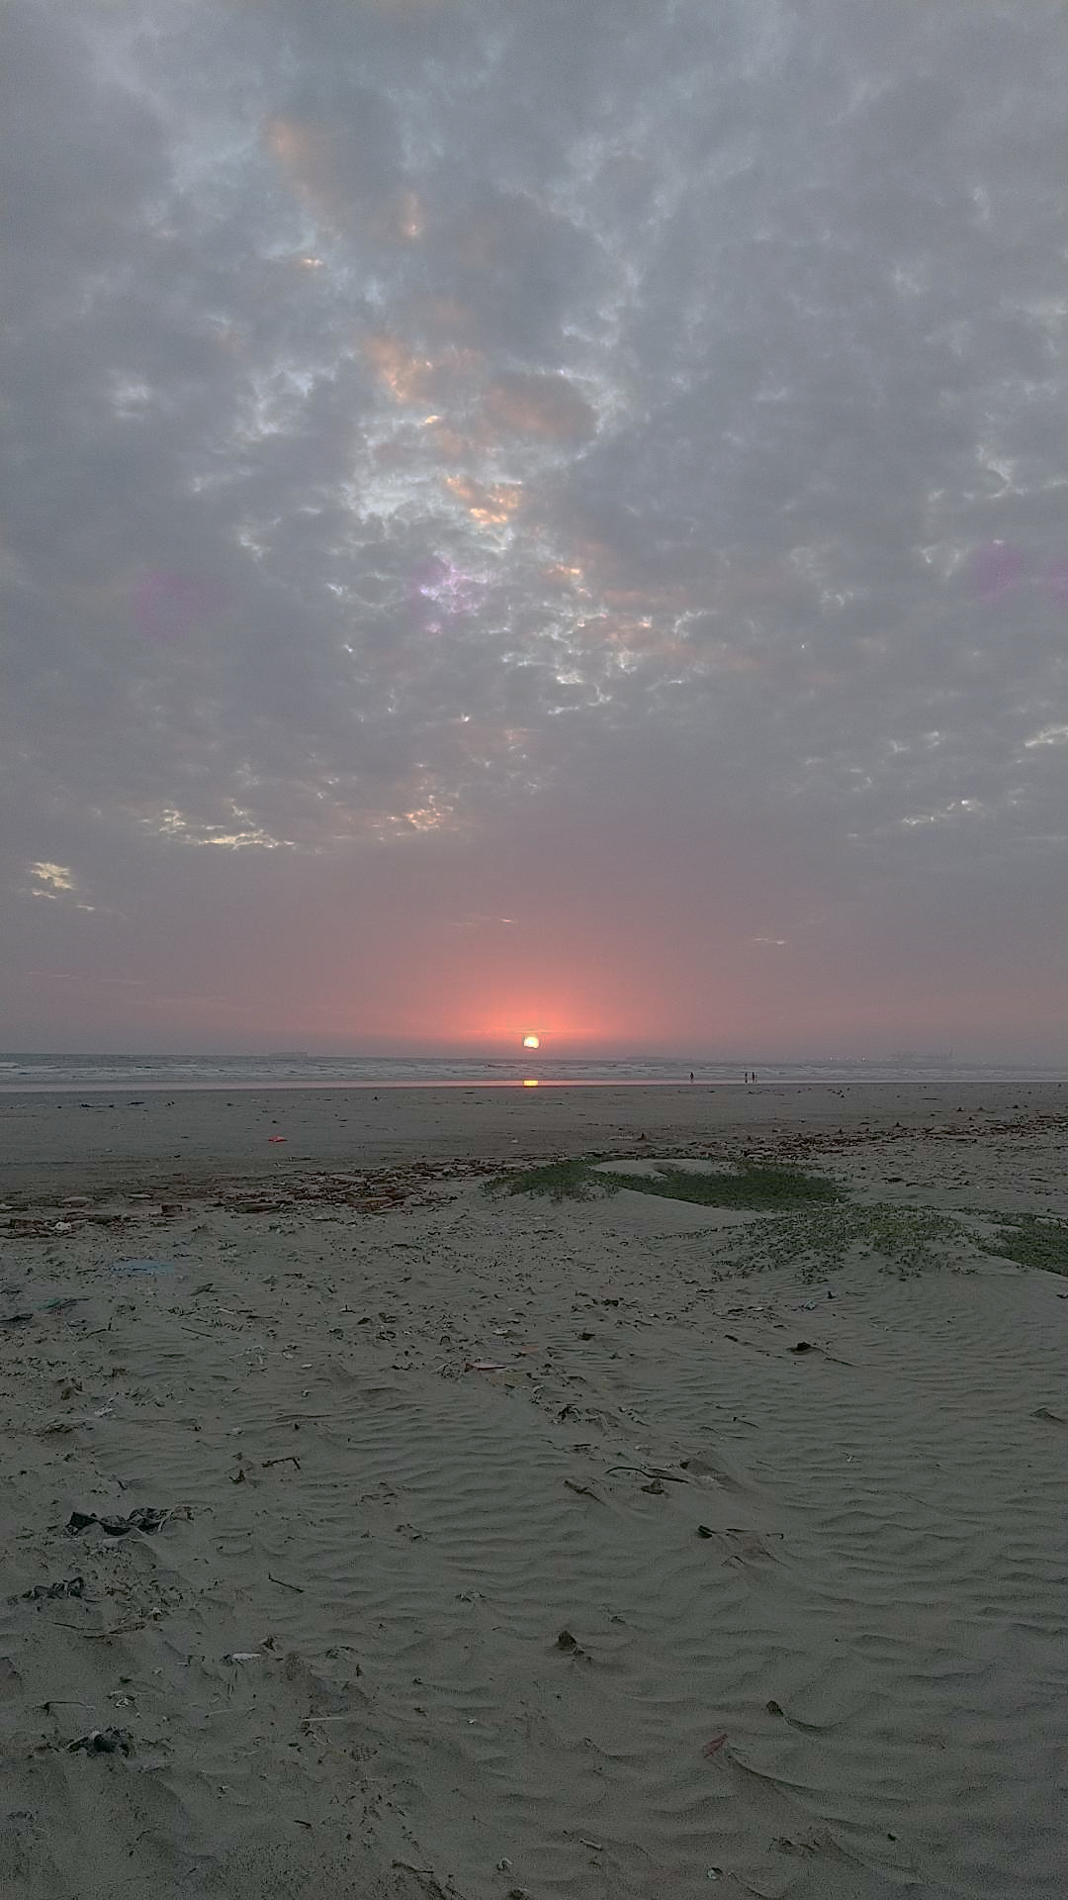
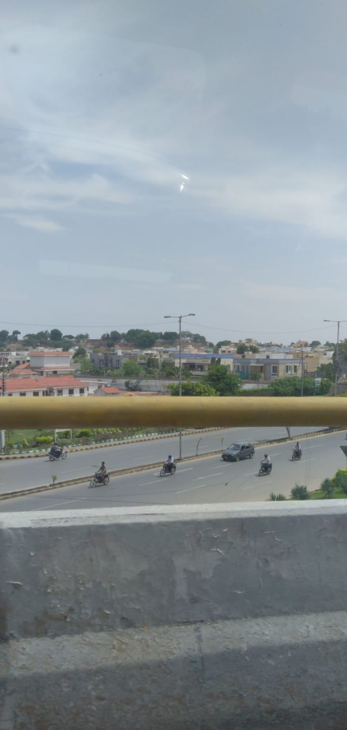
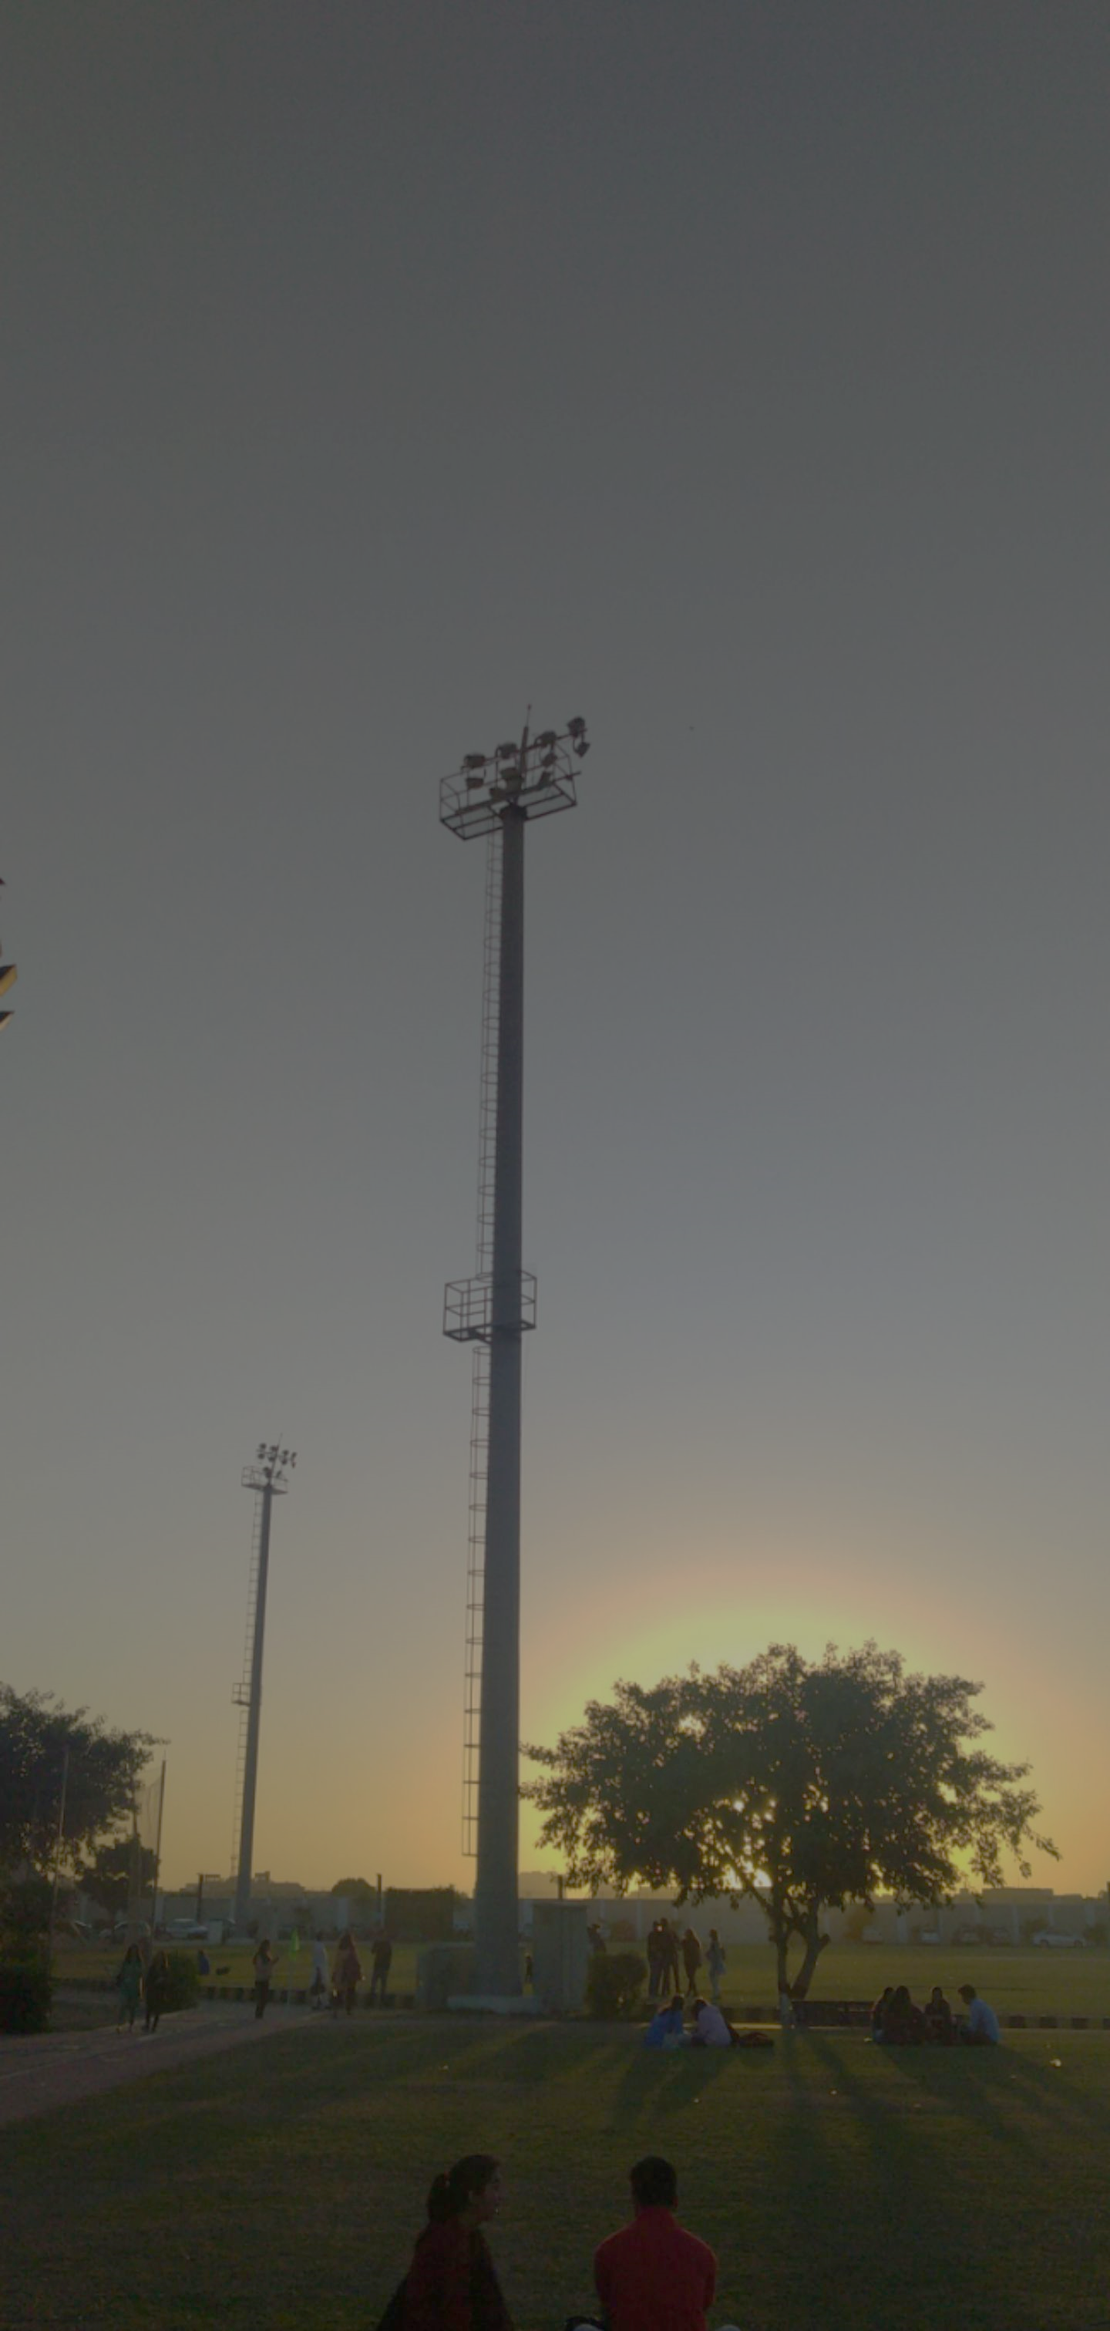
Here are some of the pictures from my daily life that I would like to share:

Slide 14
What I learned in ICA:
This course was a good experience for me because it helped me polish my typing skills. It also helped me how to use MS word and MS excel effectively. It helped me learn features about these applications I didn’t knew about.

Slide 15
Thank you for your time ! Hope you have a nice day!

